Slide 1



CAPSTONE PROJECT
Student Learning Outcome
Analysis using NAS Data
Presented By
Student Name: Sujal Pawar
College Name: vidyalankar Institute of technology
Department: electronics and computer science
Email ID: pawarsujal4455@gmail.com

Slide 2
OUTLINE:
Problem Statement (Should not include solution)
Proposed System/Solution
System Development Approach (Technology Used)
Algorithm & Deployment
Result (Output Image)
Conclusion
Future Scope
References

Slide 3
Problem Statement:
Education performance differs across states and districts in India
Difficult to identify weak regions and subjects without proper analysis
Need for data-driven insights to improve learning outcomes
Government conducts NAS survey but data needs visualization and interpretation
Objective: Analyze student learning performance using real government dataset

Slide 4
Proposed Solution:
Use NAS dataset from NDAP platform
Clean and preprocess data using Power BI Power Query
Transform dataset using Unpivot technique
Build interactive dashboard for education analysis
Compare performance across:
States
Districts
Subjects
Student participation

Slide 5
System Approach:
Data Collection:
Data Preprocessing:
Dataset downloaded from NDAP government portal
Handled missing values
Converted data types
Reshaped dataset
Data Visualization:
Tools Used:
Created bar charts, column charts, and tables
Used filters and sorting for analysis
Power BI
Excel / CSV dataset

Slide 6
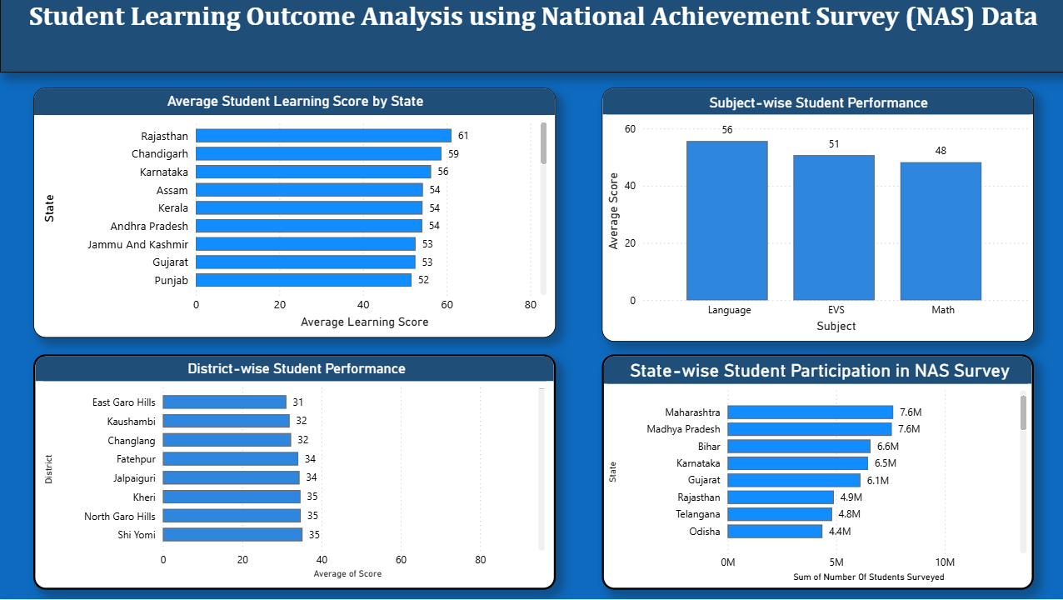
Result:
Rajasthan shows highest average student learning score
Mathematics is the most difficult subject for students
Districts like East Garo Hills and Kaushambi show low performance
Uttar Pradesh has highest student survey participation
Dashboard helps in identifying performance trends easily

Slide 7
Conclusion:
Data visualization helps in understanding education performance clearly
Weak districts and subjects can be identified for improvement
Government and institutions can use insights for policy planning
Power BI dashboards make large datasets easy to interpret

Slide 8
Future scope:
Include more years of NAS data for trend analysis
Add predictive analytics using machine learning
Expand dashboard to include school infrastructure and teacher data
Develop web-based education analytics system
Apply analysis for other countries or education systems

Slide 9
References:
GitHub Link:
NDAP Official Website — https://ndap.niti.gov.in
Power BI Documentation — https://learn.microsoft.com/power-bi
Microsoft Learn — https://learn.microsoft.com
https://github.com/SSujal-Pawarr/student-learning-outcome-analysis-powerbi

Slide 10
Thank You

